Slide 1
mL Project
-Vignesh Sridhar
Data Science September Batch

Slide 2
Problem Statement
The final goal of this project was to do predictive analysis. The dataset given to us consisted of metrics collected during the previous campaign and the aim was to use to this data to predict if a customer responded positively to the campaign or not.
The campaign in discussion is a bank marketing campaign.
Link to video explanation - https://drive.google.com/open?id=1ZbL5L_fwdKv3BqwVEPfephCsP3c38koL

Slide 3
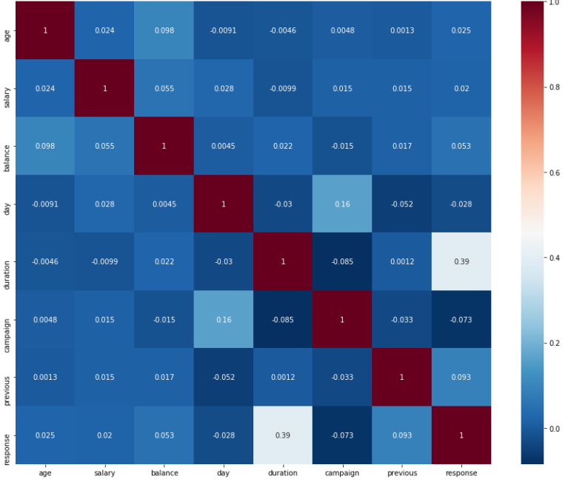
Approach and reasoning
EDA – Exploring the data using graphs and correlation matrix to find which predictors explain the target variable(response) the best.
Initial analysis using correlation matrix revealed that none of the predictors had a strong relation with our target variable.

Slide 4
Approach and reasoning
Feature Engineering - Upon further bivariate analysis it was found that one of the predictors(pdays) had approx. 82% of the values as -1. -1 indicated that the customer had not been contacted or data was missing. Since there was no concrete use of this column, a decision was made to drop this column.
Poutcome also had approx. 82% of unknown values. I replaced all the unknown values with “others” as unknown values can come under this category and it would further reduce the bifurcation.
After this, I split my dataset into train and test sets to train and test my model.
Performed MinMax scaling and one hot encoding to prepare the dataset. It is always advisable to perform this task after splitting the dataset to avoid data leakage.
Modeling - A basic regression model was built initially which took into account all predictor variables available.
To increase efficiency of the model, Recursive Feature Elimination was used(RFE). I chose to select the best 5 predictors and train my logistic regression model again.
After this, I verified the VIF and P values to ensure there was no multi-collinearity amongst the predictor variables. Upon doing this, there was no multi-collinearity found.

Slide 5
Approach and reasoning
After verifying the accuracy scores for both models I found that there was no big difference between the two. Hence, I stuck with the model using just 5 predictor variables.
After training my model with 5 predictor variables, I used cross-validation to verify the authenticity of my model. The cross validation score proved my model to be good.
Now I ran my model with the test set and managed to get a very good precision ,recall and accuracy score.
Now the same approach was repeated with the Random Forest Classifier model.
The model again managed performed well on the test set.
INFERENCE:
In spite of not being highly correlated with our target variable ,the data from the previous campaign proved useful to predict the response of the customers.

Slide 6
Result
Model | Logistic Regression | Random Forest Classifier
No. of predictors used | 5 | 5
Predictors used | x9_failure(poutcome), x9_other(poutcome), balance, duration, campaign | x9_success(poutcome), age, balance, day, duration
Accuracy Score | 0.8961627778392126 | 0.8930664602454937
Precision | 0.88 | 0.88
Recall | 0.90 | 0.89

